Slide 1
Survey of Machine Learning Feature Selection Methods: Boruta, SVD, PCA, LASSO, RFE, …
Earl F Glynn
Kansas City R Users Group
2018-09-08
https://github.com/EarlGlynn/kc-r-users-feature-selection

Slide 2

Continuation from last year …

Slide 3
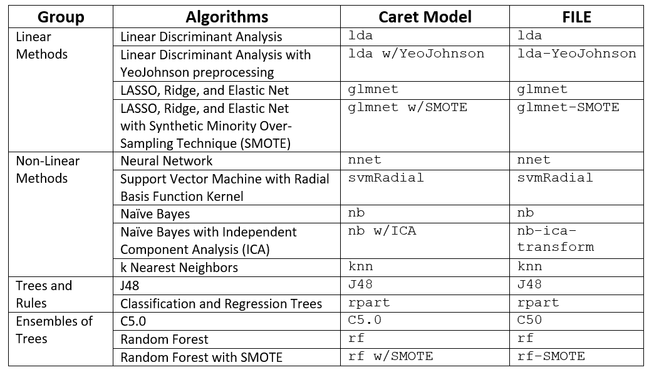

From last year …. Caret Machine Learning Examples
https://github.com/EarlGlynn/kc-r-users-caret-2017
Files: Forensic-Glass-caret-FILE.Rmd and Forensic-Glass-caret-FILE.html

Slide 4
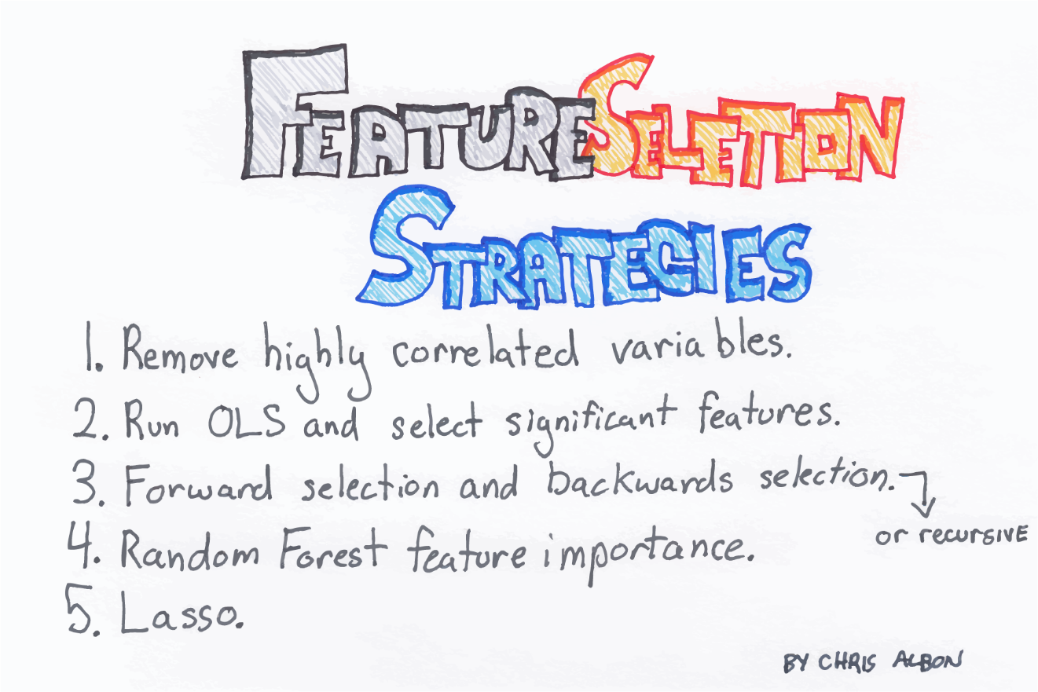

Survey of …
@ChrisAlbon machinelearningflashcards.com
6. Boruta “All Relevant” Variables
7. SVD (Singular Value Decomposition)
8. PCA (Principal Component Analysis)

Slide 5
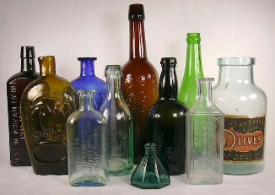
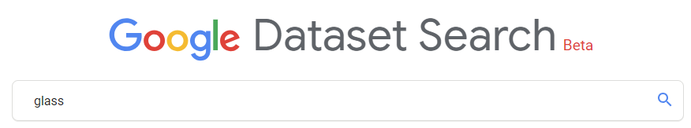
Small dataset used in examples: Forensic Glass Dataset
https://sha.org/bottle/links.htm
fgl dataset in MASS package
RI = refractive index
Percentages by weight of oxides: Na, Mg, Al, Si, K, Ca, Ba, Fe
Predict type from measured values above
window float glass (WinF)
window non-float glass (WinNF)
vehicle window glass (Veh)
containers (Con)
tableware (Tabl)
vehicle headlamps (Head)
https://toolbox.google.com/datasetsearch
Also available through UCI Repository.
Discussed in book Data Mining and Business Analytics with R.

Slide 6
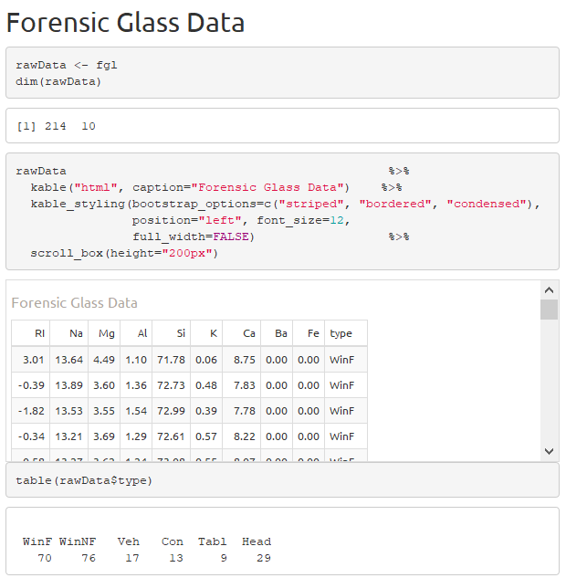

Forensic Glass Dataset
Class imbalance
Files: Forensic-Glass-Boruta.Rmd and Forensic-Glass-Boruta.html

Slide 7
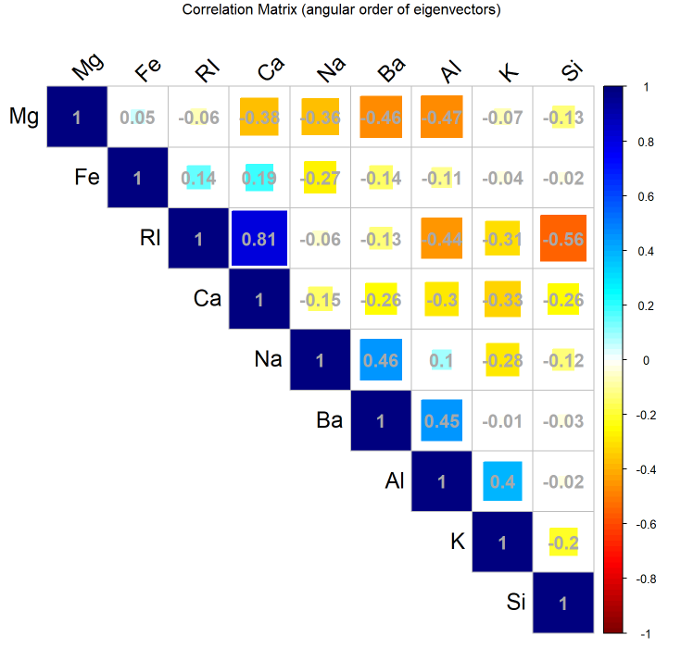
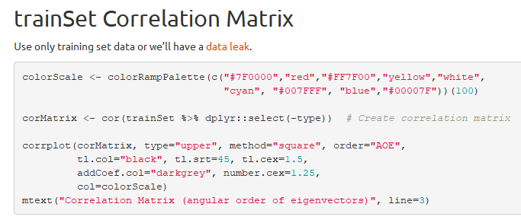
Feature Selection 1. Remove Highly Correlated Variables
order=“AOE” (angular order of eigenvalues)
http://www.datavis.ca/papers/corrgram.pdf, p.5
Files: Forensic-Glass-Correlation.Rmd and Forensic-Glass-Correlation.html

Slide 8
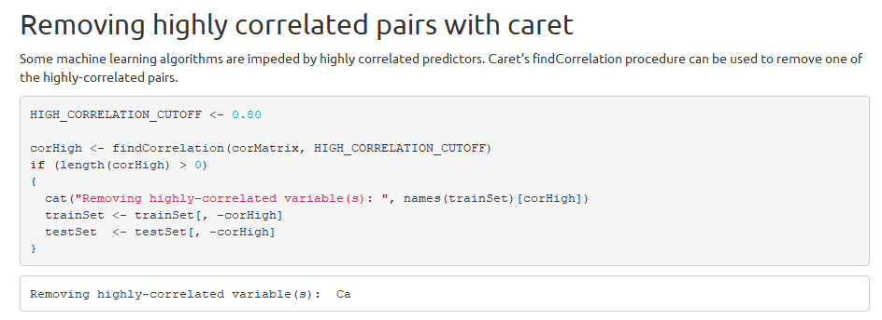
Feature Selection Remove Highly Correlated Variables
I often use a cutoff of 0.9 or above, but here 0.8 is used to trigger a removal.
Note: Remove constant variables, too.
Files: Forensic-Glass-Correlation.Rmd and Forensic-Glass-Correlation.html

Slide 9
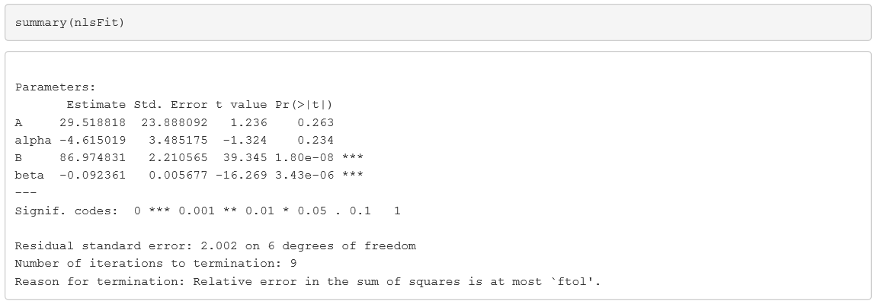
Feature Selection 2. Run OLS and select significant features
OLS = Ordinary Least Square, but approach also applies to NLS = Non-linear Least Squares, e.g., Levenberg-Marquardt non-linear curve fitting
library(minpack.lm) # nls.lm

Slide 10
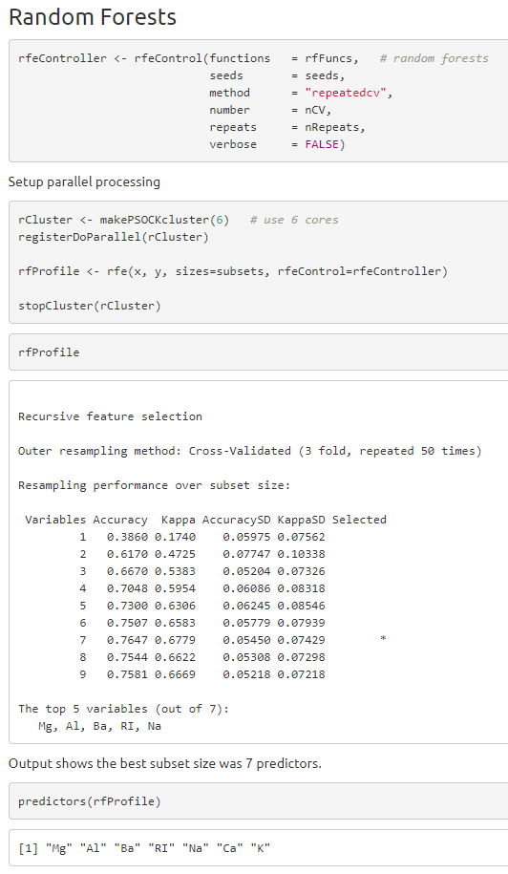
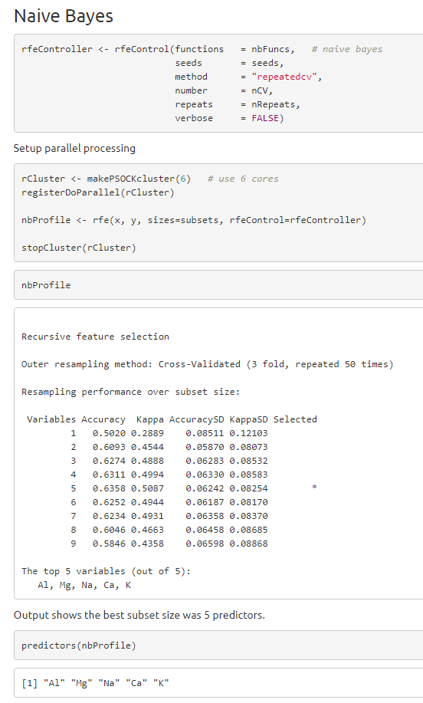
Feature Selection 3. Caret’s Recursive Feature Extraction (RFE)
-Si -Fe
-RI -Si -Ba -Fe
Files: Forensic-Glass-caret-RFE.Rmd and Forensic-Glass-caret-RFE.html

Slide 11
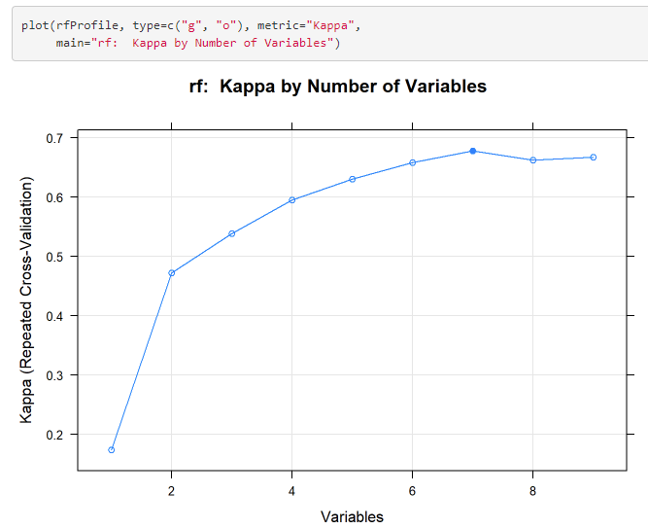
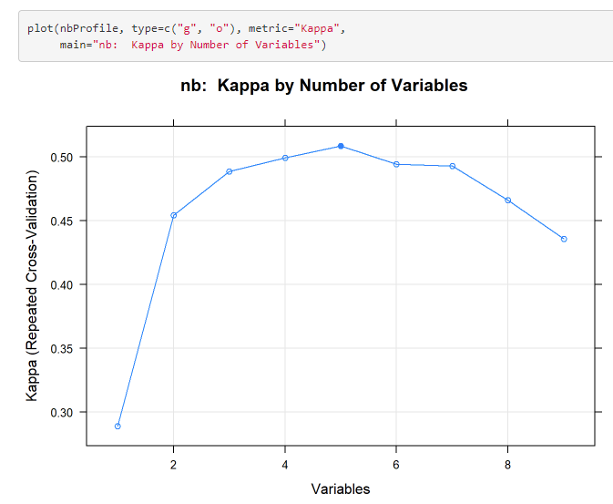
Feature Selection Caret’s Recursive Feature Extraction (RFE)
7
5
Kappa is generally a better metric than Accuracy with imbalanced classification.
Files: Forensic-Glass-RFE.Rmd and Forensic-Glass-RFE.html

Slide 12
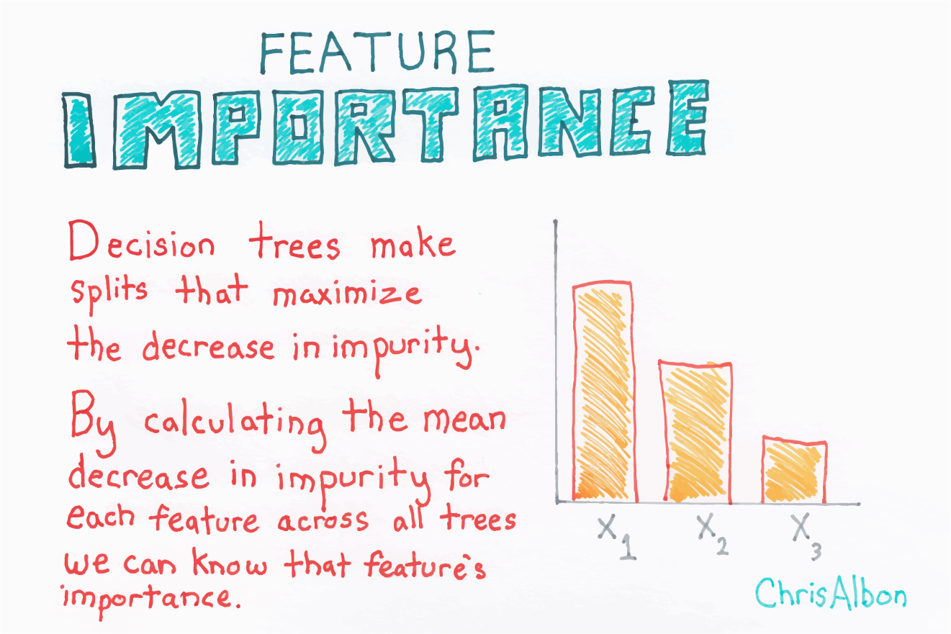
Feature Selection 4. Feature Importance
@ChrisAlbon machinelearningflashcards.com

Slide 13
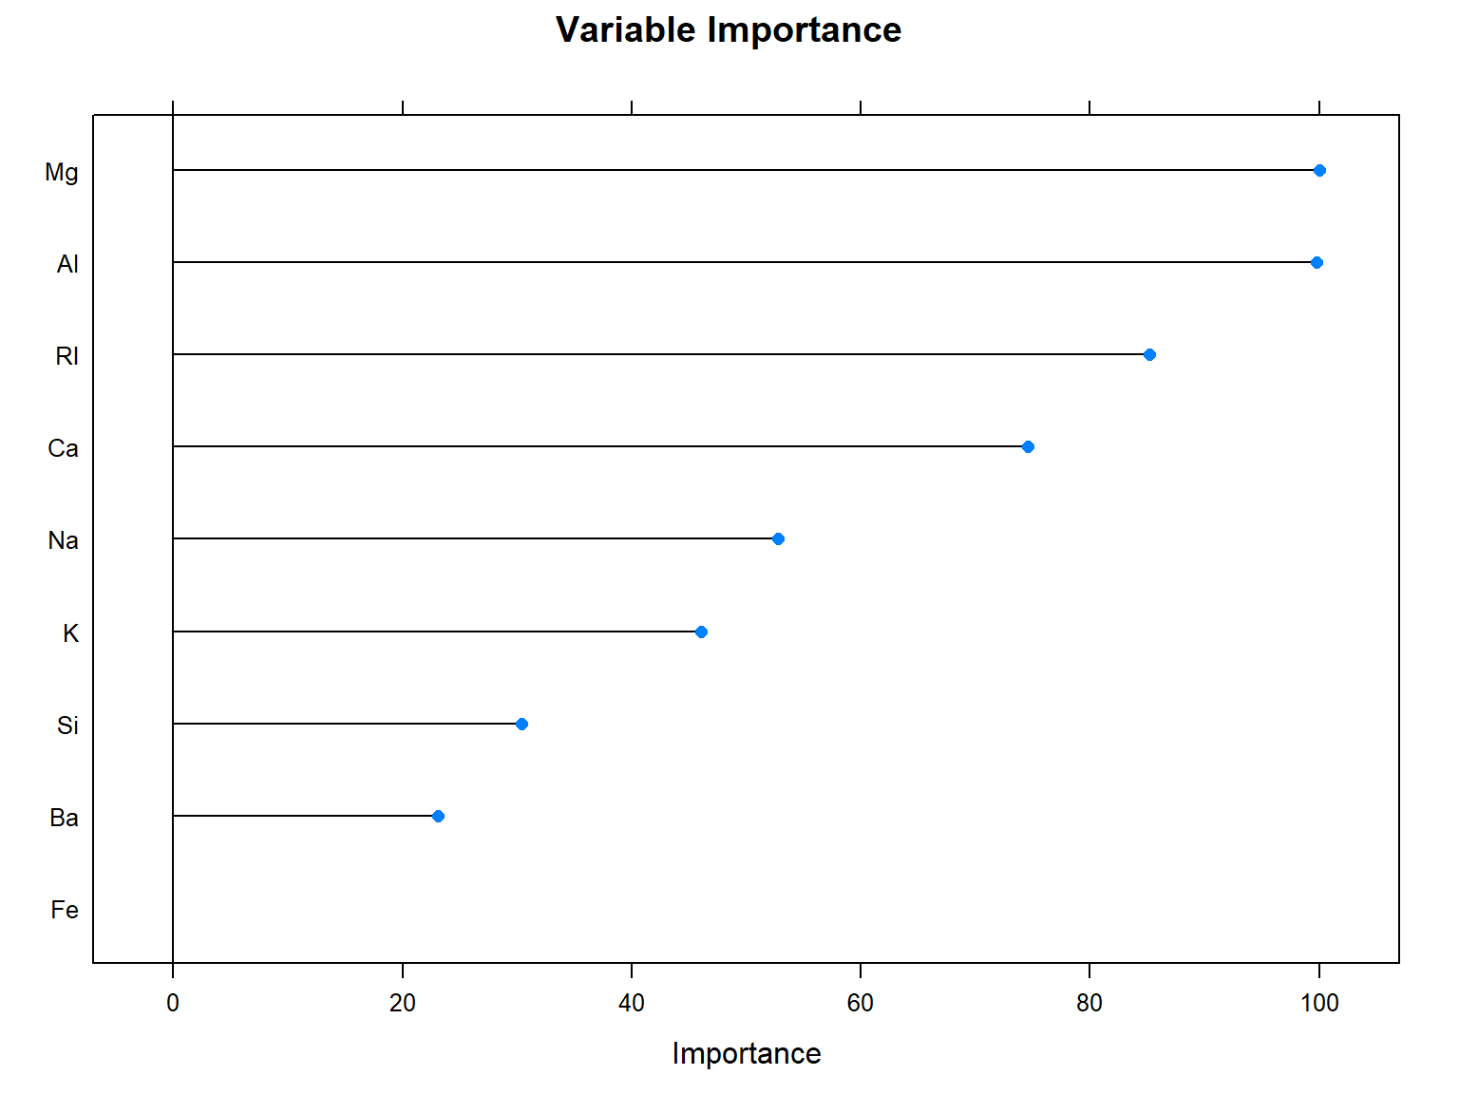
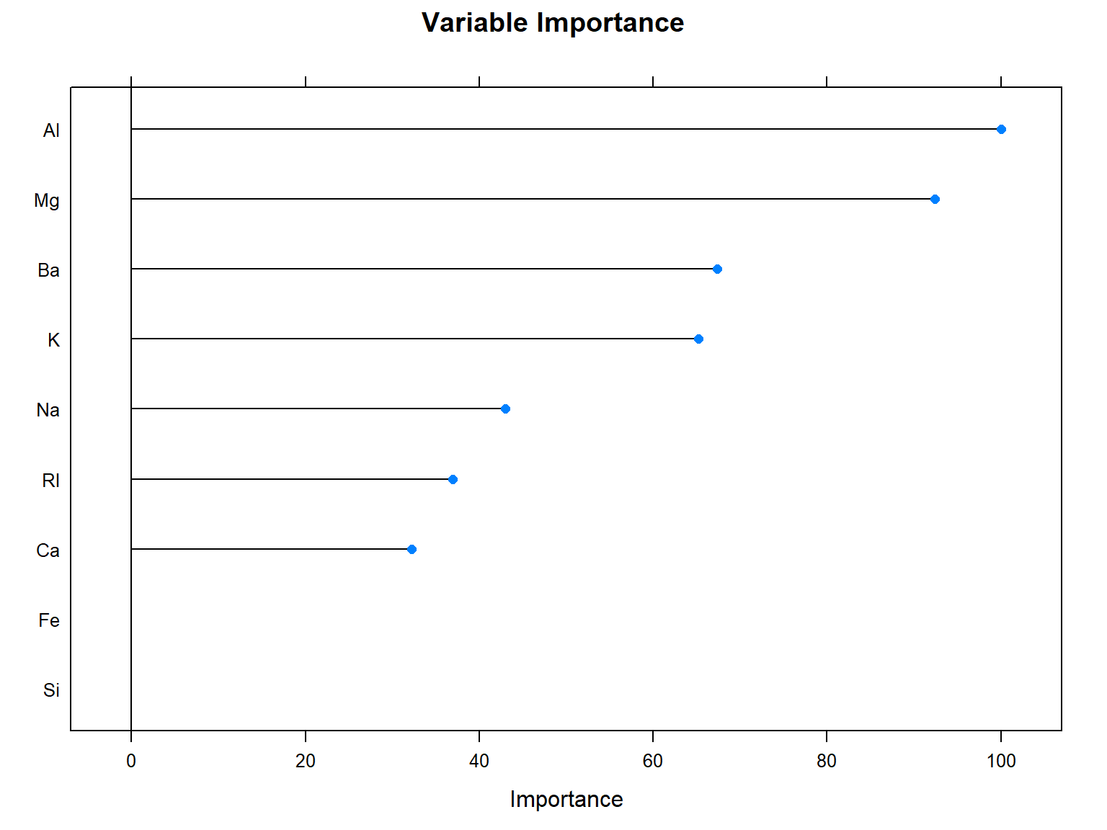
Feature Selection 4. Feature Importance
Use feature importance from one or more machine learning models to select features.
Study consistency and differences among models. Single Predictors here.
Tree Method
Ensemble of Trees Method
Random Forest Classification
Classification and Regression Trees
2017 Files: Forensic-Glass-caret-rf.html and Forensic-Glass-caret-rpart.html

Slide 14
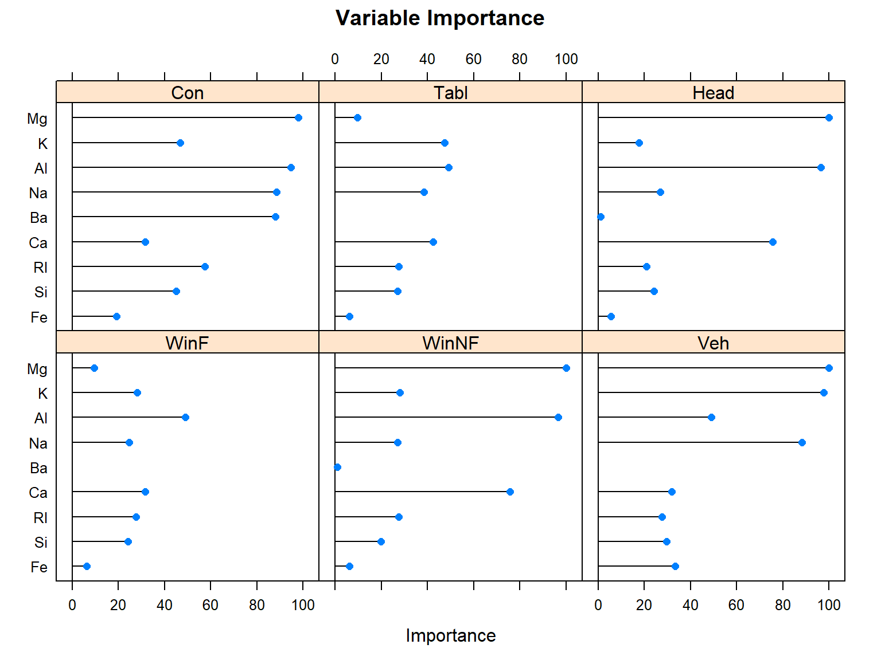
Feature Selection Feature Importance
Use feature importance from one or more machine learning models to select features.
Study consistency and differences among models. Separate Predictors, Very Similar.
Linear Method
Non-Linear Method
Linear Discriminant Analysis
Naïve Bayes Classifier
2017 Files: Forensic-Glass-caret-lda.html and Forensic-Glass-caret-nb.html

Slide 15
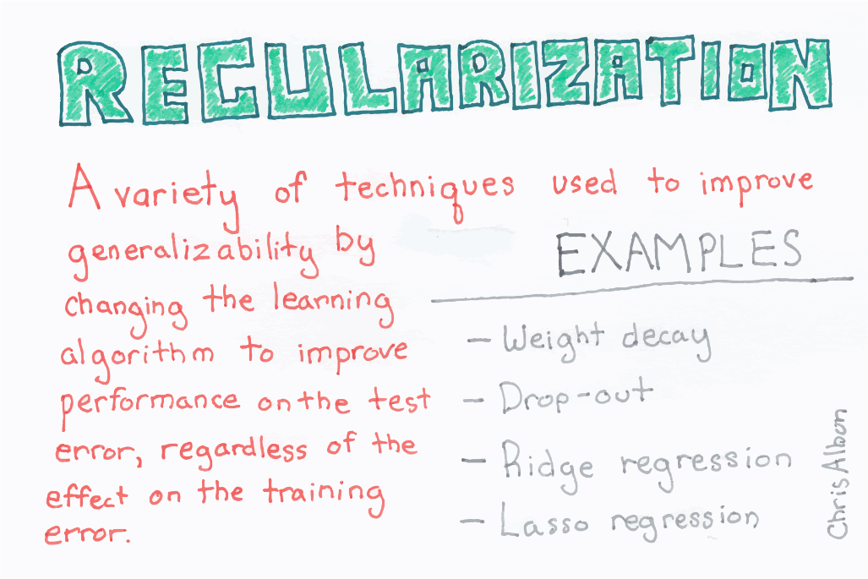
Feature Selection 5. glmnet
Ridge, Lasso and Elastic-Net Regularized Generalized Linear Models
(α=0 for Ridge, α=1 for Lasso)
Math is a bit complicated: https://quantmacro.wordpress.com/2016/04/26/fitting-elastic-net-model-in-r/ https://web.stanford.edu/~hastie/glmnet/glmnet_alpha.html
Idea is to force some coefficients to zero to exclude from model.
@ChrisAlbon machinelearningflashcards.com

Slide 16
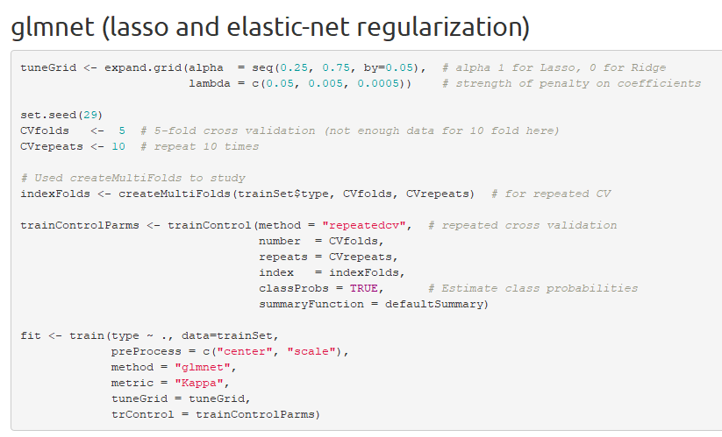
Feature Selection glmnet
Forensic-Glass-caret-glmnet.Rmd and Forensic-Glass-caret-glmnet.html

Slide 17
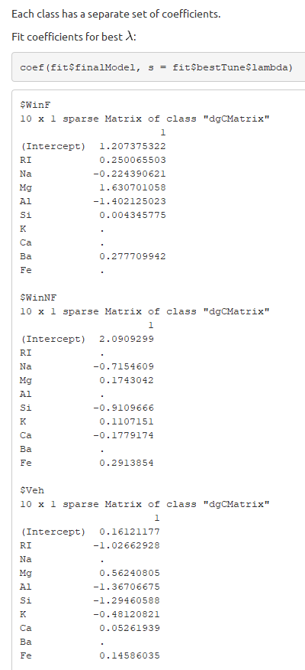
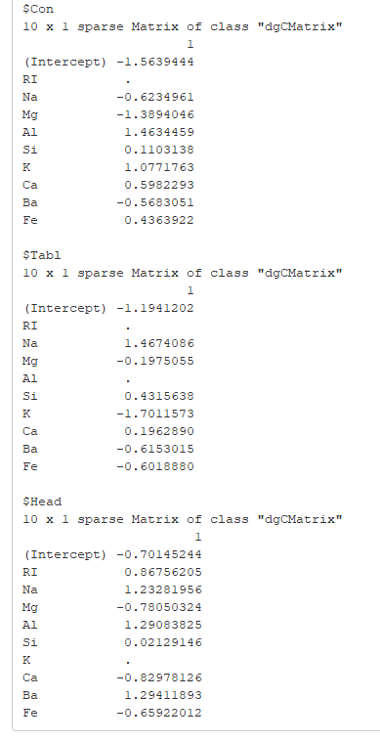
Feature Selection glmnet
glmnet creates a separate model for each class.
Some coefficients are driven to zero by the method, which effectively excludes predictor from model.
glmnet can be used as a prediction model, or as a tool to select relevant variables for other models.
Forensic-Glass-caret-glmnet.Rmd and Forensic-Glass-caret-glmnet.html

Slide 18
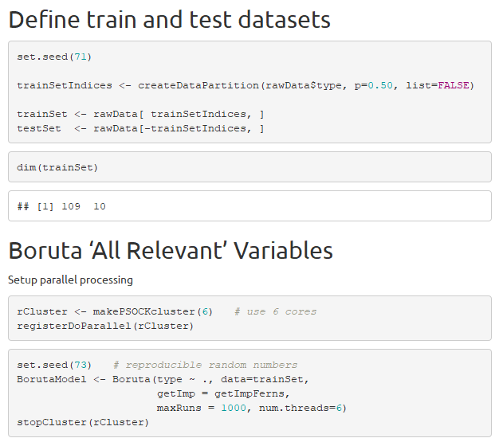

Feature Selection 6. Boruta “All Relevant” Variables
Will vary by platform
No data
pre-processing
needed!
Boruta was a demon/god in Slavic mythology, who lived in trees. https://www.pinterest.com/pin/497577458807361039/

Slide 19
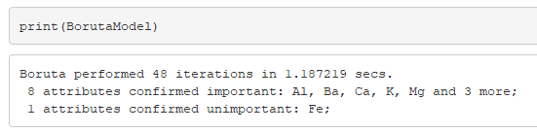
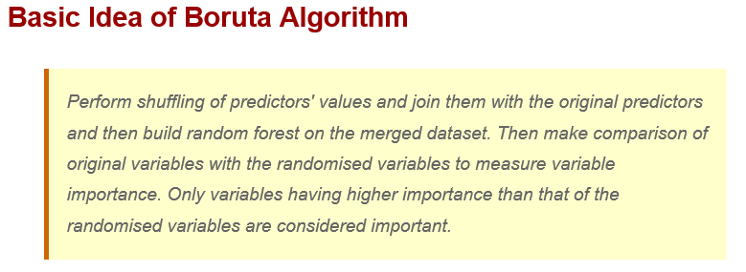
Feature Selection Boruta “All Relevant” Variables
https://www.listendata.com/2017/05/feature-selection-boruta-package.html
https://www.datacamp.com/community/tutorials/feature-selection-R-boruta
Files: Forensic-Glass-Boruta.Rmd and Forensic-Glass-Boruta.html

Slide 20
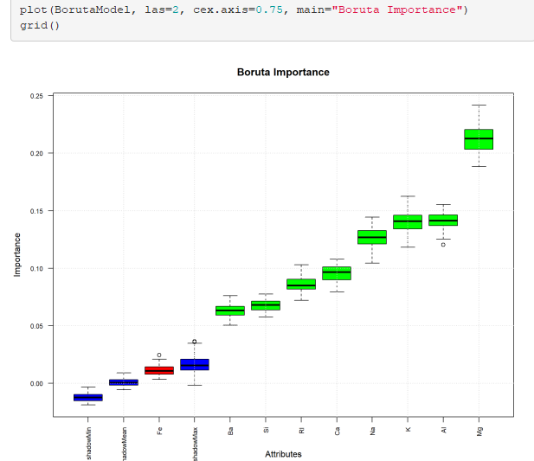
Feature Selection Boruta “All Relevant” Variables
Accept
Reject
Files: Forensic-Glass-Boruta.Rmd and Forensic-Glass-Boruta.html

Slide 21
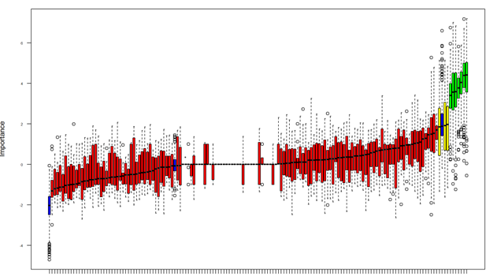
Feature Selection Boruta “All Relevant” Variables
Sometimes Boruta approach can be very helpful with selections
Accept
Marginal
Reject

Slide 22
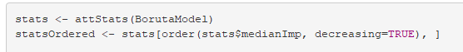
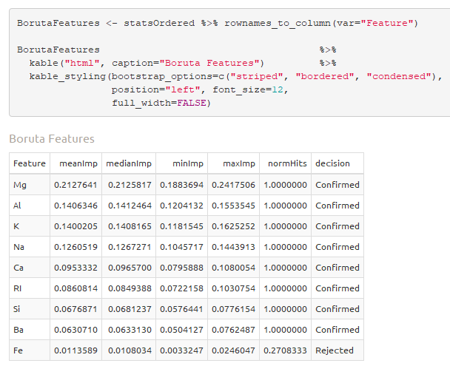
Feature Selection Boruta “All Relevant” Variables

Slide 23
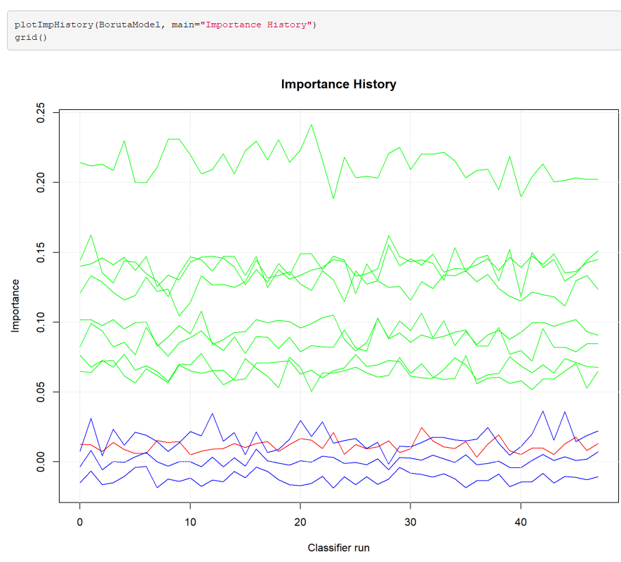
Feature Selection Boruta “All Relevant” Variables

Slide 24
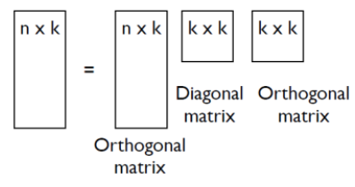
Feature Selection 7. Singular Value Decomposition
Dataset is a matrix of 214 rows of 9 predictors.
Original matrix can be written as a product of three matrices with svd.
Diagonal of middle matrix contains the singular values (eigenvalues if centered data).
Right-most matrix contains the right singular vectors, which can give information about feature importance.
Train = U x ∑ x V^{T}
0
Train Matrix = U x ∑ x V^{T}
In R:
svd1 <- svd(scale(trainData))
svd1$u %*% diag(svd1$d) %*% t(svd1$v)
U = left singular vectors = 214-by-9 unitary matrix. svd1$u in R.
∑ = singular values matrix = 9-by-9 diagonal matrix. diag(svd1$d) in R. The diagonal terms are the singular values, usually listed in decreasing order.
V^{T} = transpose of V, where V = right singular vectors = 9x9 unitary matrix. svd1$v in R.
0
Matrix diagram: http://bigdata-madesimple.com/decoding-dimensionality-reduction-pca-and-svd/

Slide 25
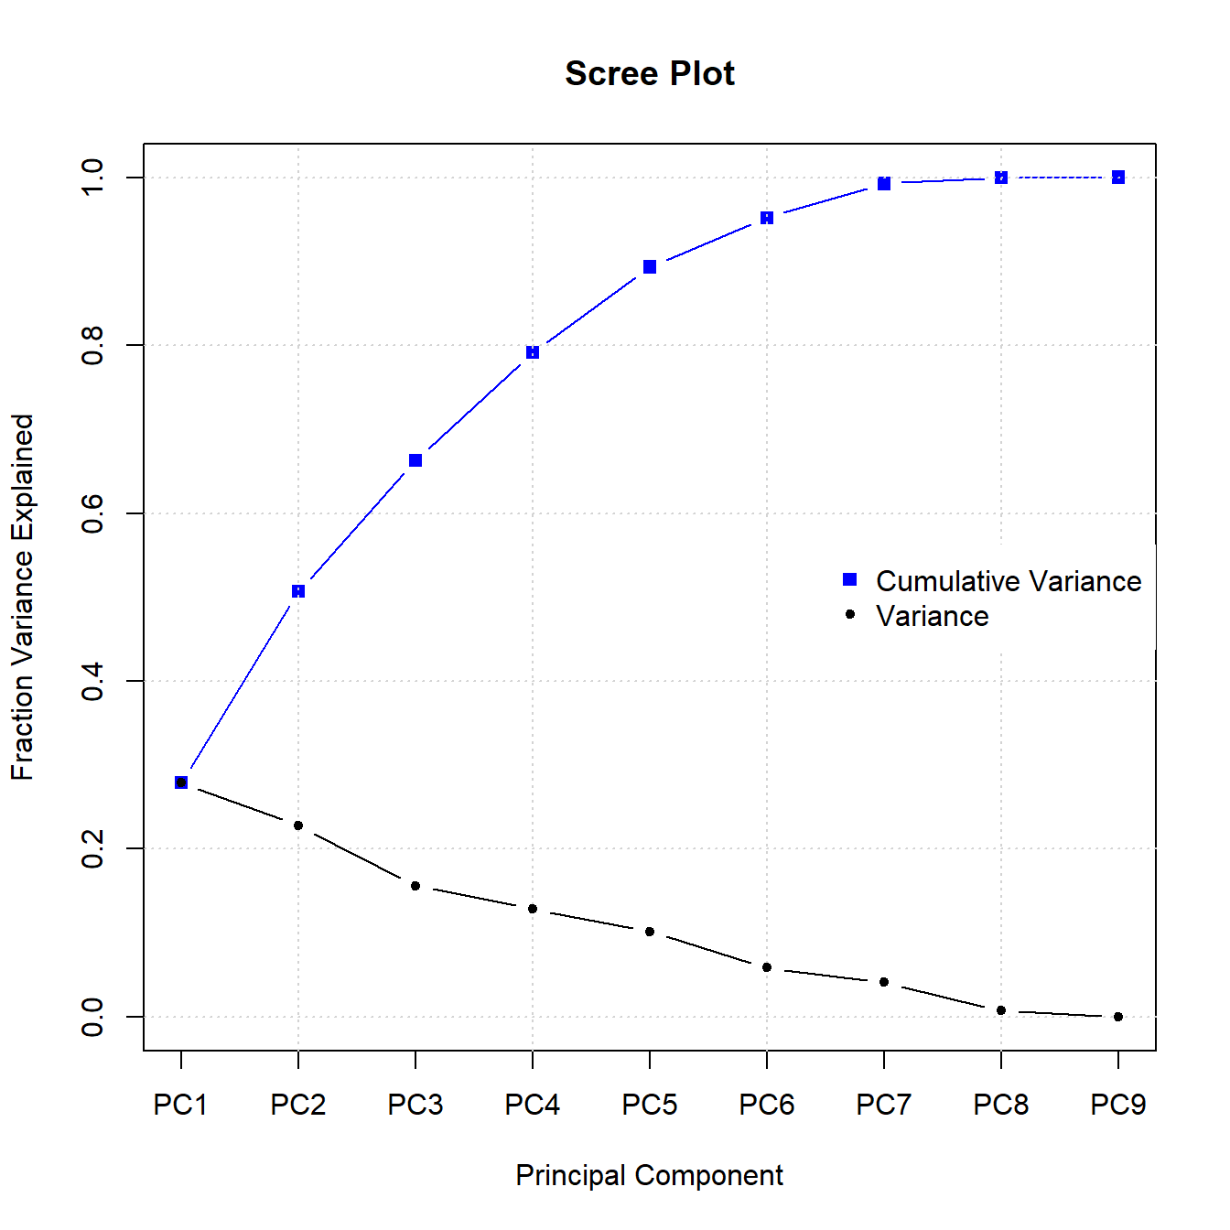
Feature Selection Singular Value Decomposition
Singular values are usually in decreasing order. 1st one largest.
Square of n^{th} singular value proportional to variance associated with n^{th} singular vector.
Often few terms explain large % of total variance.
Cumulative variance explained:
[1] 0.2790 0.5068 0.6629 0.7915 0.8931 0.9517 0.9927 0.9998 1.0000
Files: Forensic-Glass-SVD.Rmd and Forensic-Glass-SVD.html

Slide 26
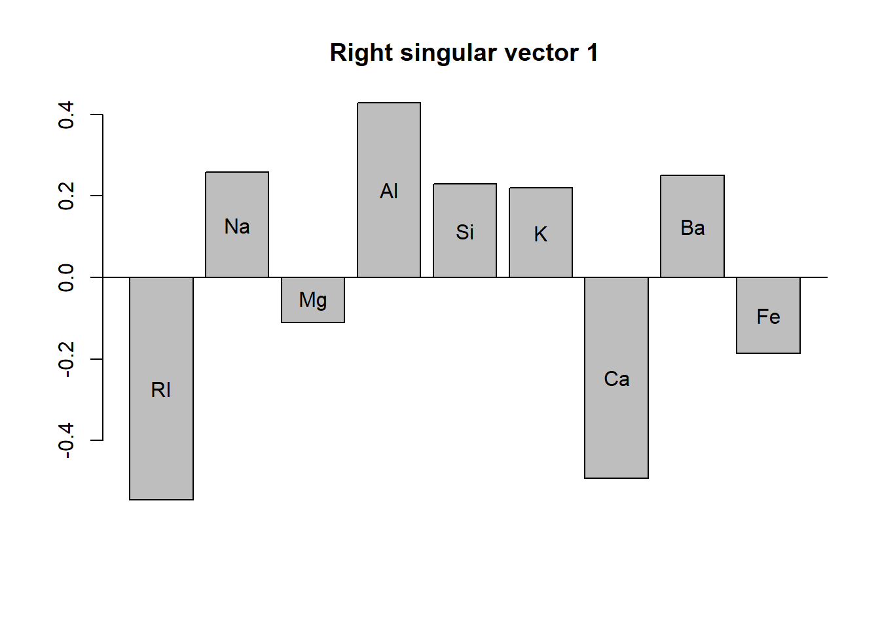
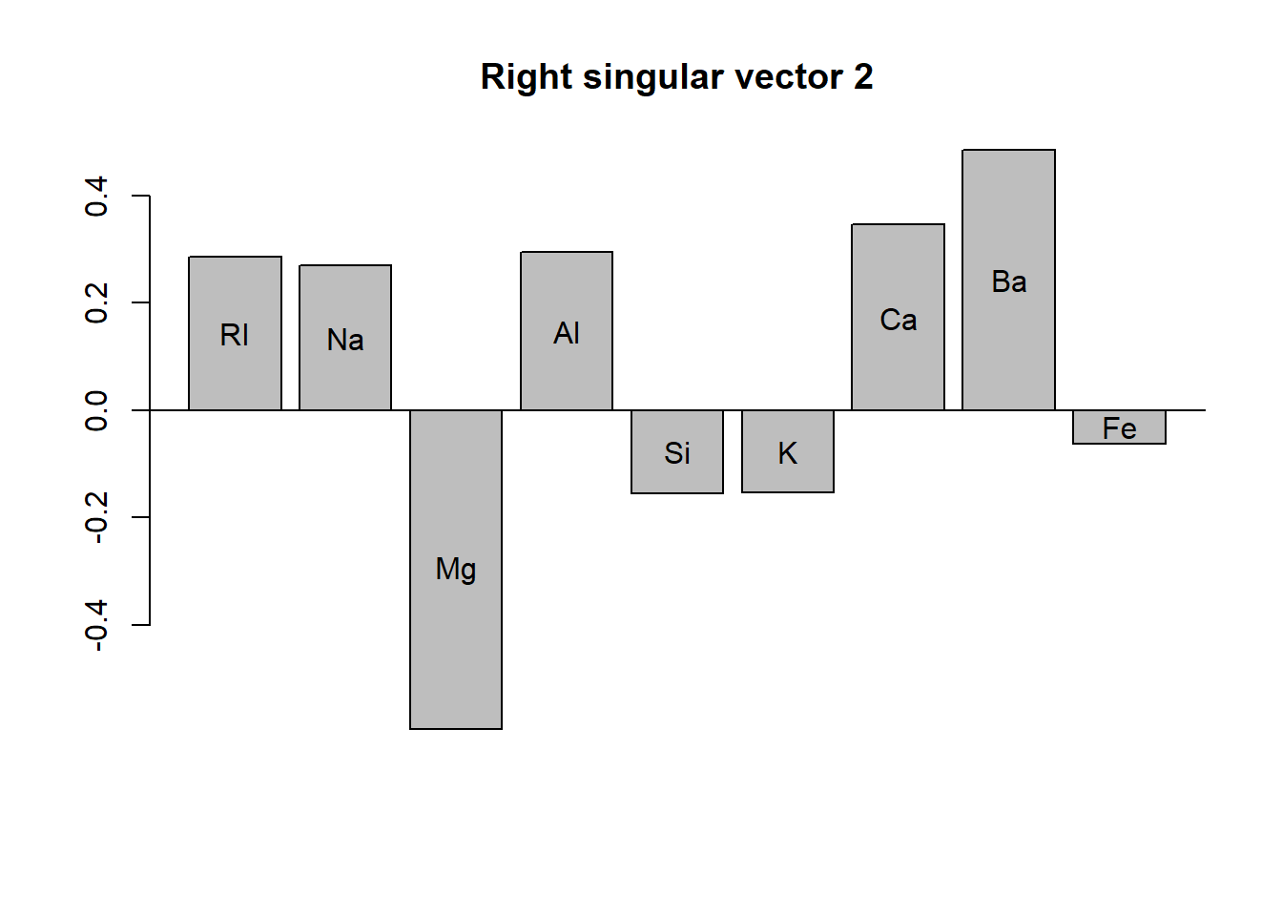
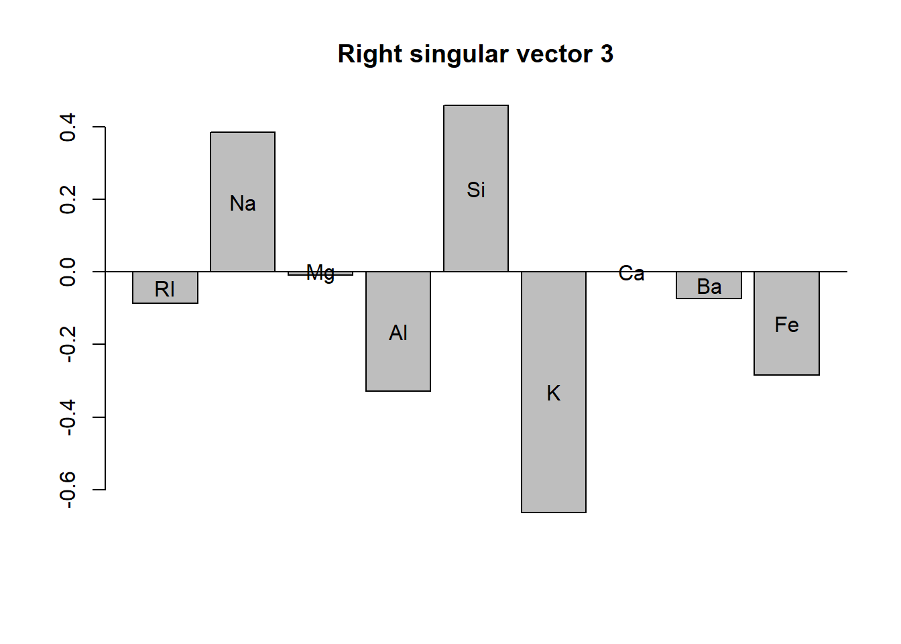
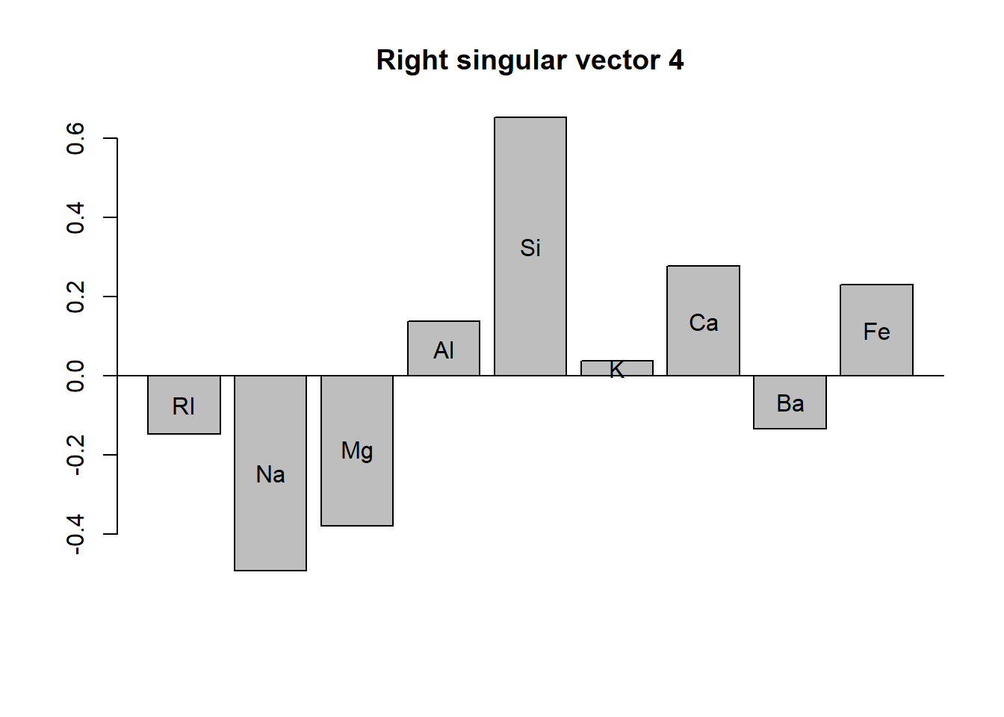
Feature Selection Singular Value Decomposition
28% of variance
23% of variance
16% of variance
13% of variance
Pick variables with large contributions (+ or -): 1: RI, Ca, Al; 2: Mg, Ba; 3: K, Si

Slide 27
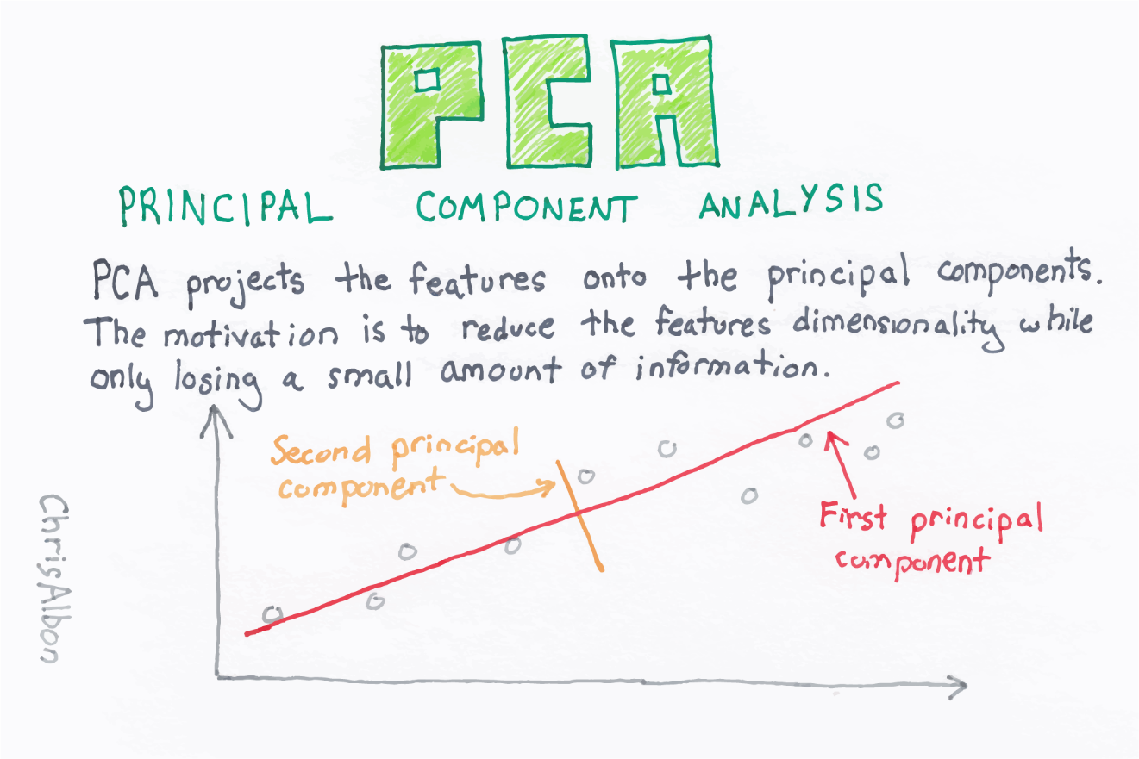
Feature Selection 8. Principal Component Analysis
PCA often computed from SVD
@ChrisAlbon machinelearningflashcards.com

Slide 28
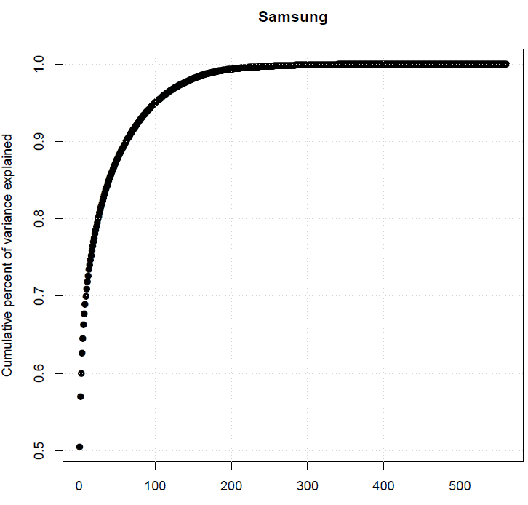
Feature Selection SVD / PCA
Right singular vector can help with interpretation of a principal component. Here, 9 of 500+ PCs explained over 70% of total variance. Could use 9 PCs in machine learning that explain over 70% of variance instead of 500+ predictors.

Slide 29
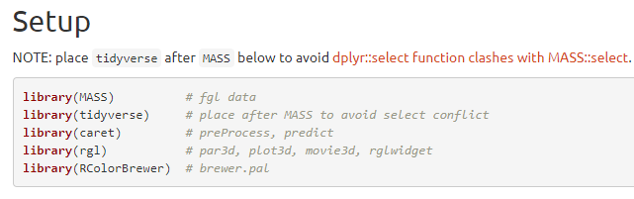
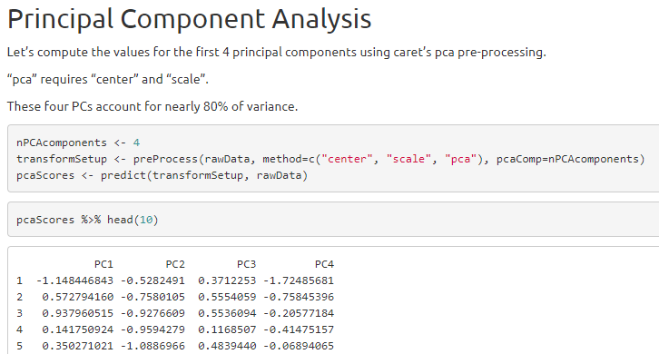
Feature Selection Principal Component Analysis
Files: Forensic-Glass-PCA.Rmd and Forensic-Glass-PCA.html

Slide 30
Feature Selection Principal Component Analysis
caret’s preProcess gives the same PCAscores as computed with SVD.
Each PC is a weighted linear combination of all variables.
PCs are orthogonal.
PCs can be used as variables in other machine learning algorithms.
Machine learning algorithm using PCs as predictors are limited by the amount of variance explained by the original variables in the given number of PCs.

Slide 31
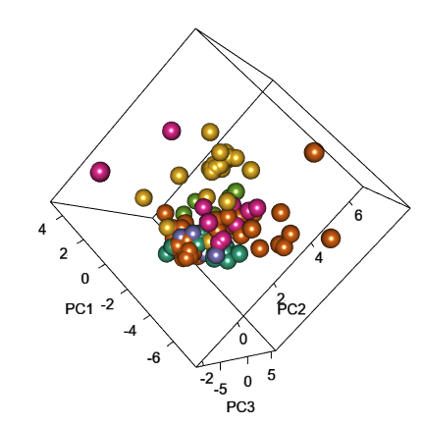
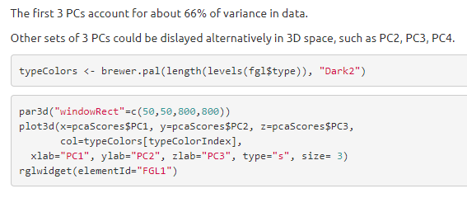

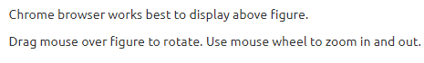
Interactive Exploratory Analysis Principal Component Analysis
Use plot3d in rgl package to create interactive 3D scatterplot of any three PCs
Files: Forensic-Glass-PCA.Rmd and Forensic-Glass-PCA.html

Slide 32
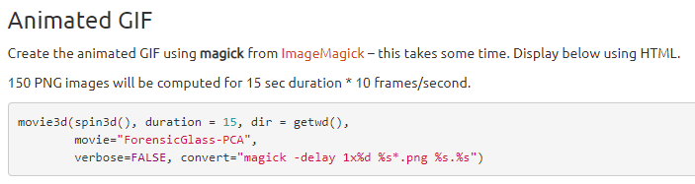
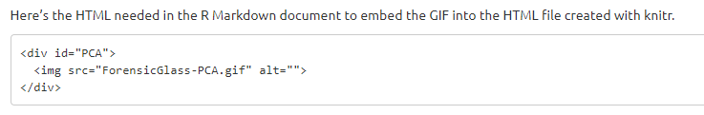
Exploratory Analysis Principal Component Analysis
magick from ImageMagick needed to create animated GIF of 3D PCA scatterplot
Files: Forensic-Glass-PCA.Rmd and Forensic-Glass-PCA.html

Slide 33

Exploratory Analysis Principal Component Analysis
Files: Forensic-Glass-PCA.Rmd and Forensic-Glass-PCA.html

Slide 34
Take Home
Variety of ways to select features for machine learning models.
Explore several methods.
Boruta often easy to apply without much data preparation. Many methods require pre-processing, like centering and scaling.
Experiment only with training data to avoid “data leaks” and overfitting.

